Slide 1
Path to Recovery
Presented by
Sharon Atwood

Slide 3
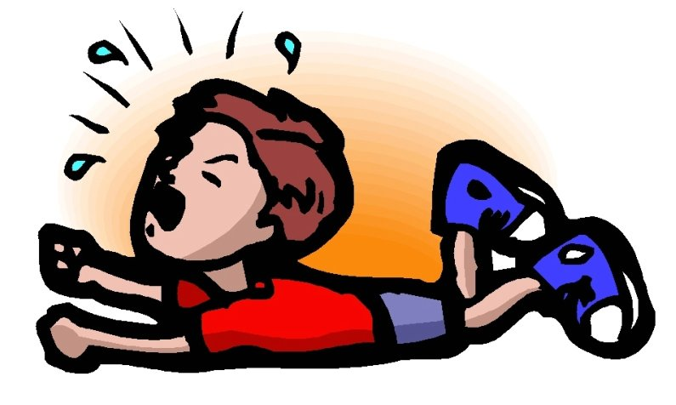
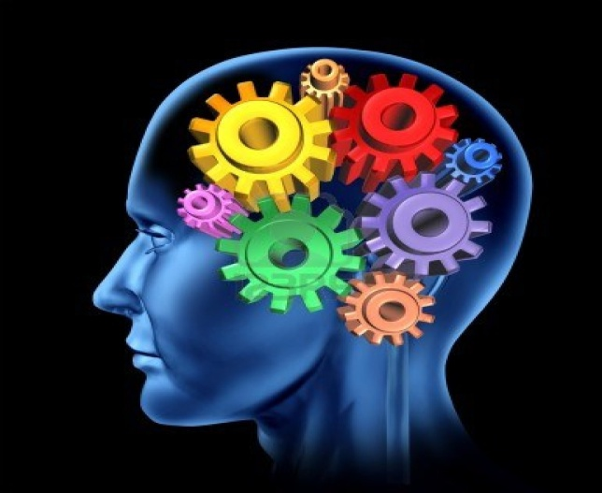
Categories of Mental Health Issues

Slide 4
Mental health issues affect:
1 in ___
4

Slide 5
Causes

Slide 6
ASD
BPD
PTSD
DID
BP
OCD
GAD

Slide 7
Positive Coping Strategies

Slide 8
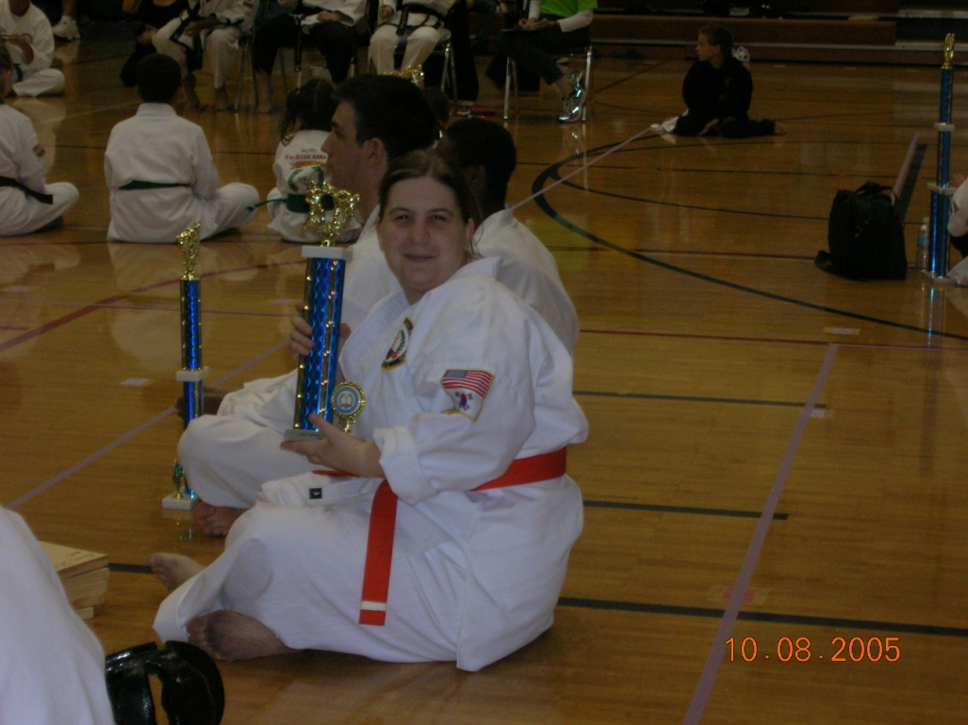

Slide 9
Catch It!
Check It!
Change It!

Slide 10
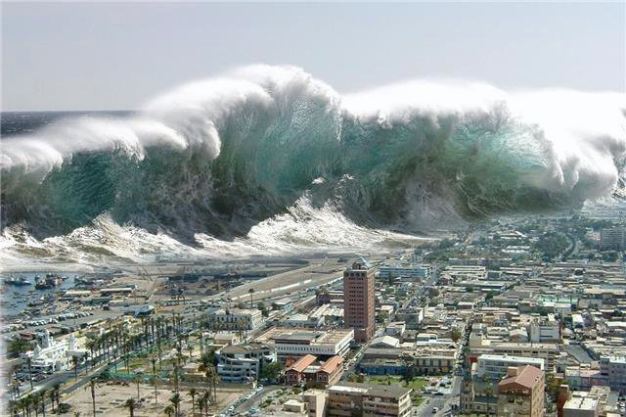

Slide 13
Benefits Must
Outweigh the
Side Effects!

Slide 14
Not a Dictatorship!

Slide 15
Crisis
Intervention
Team

Slide 16
